Slide 1
Chapter 9-Graphs
“One graph is worth a thousand logs.”
Michal Aharon, Gilad Barash, Ira Cohen and Eli Mordechai.

Slide 2
Why study this chapter?
Relationship between computers (in a computer network)
Relationship between cities (in a digitalized map, Google map)
Relationship of webpages (on the internet)
Relationship between people (in a social network, very hot topic of research)
etc.

Slide 3



Introduction to GRAPH THEORY

Slide 4
Introduction
Represent
relations (edges)
between
objects (vertices)
Facebook users
phone numbers
people
webpages
computers
processors
cities
switches

Slide 5
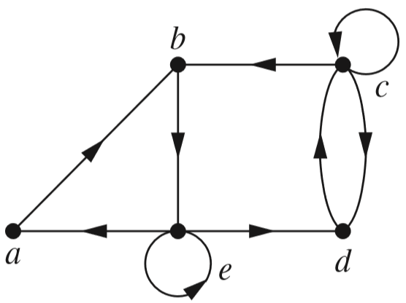
Introduction
A network with 5 websites and links

Slide 6
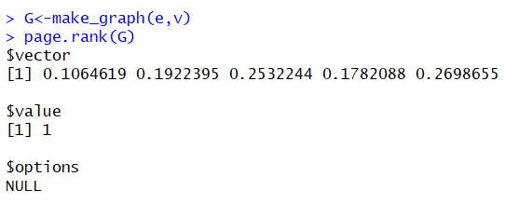
Google PageRank
PageRank is a ranking for webpages based on their importance.
Google PageRank: to rank webpages on the Internet
eigenvector
eigenvalue
G

Slide 7
Our goal
Graphs and special simple graphs
Bipartite graphs
Isomorphism
Connectivity
Graph representations
Shortest path problems
Euler paths and Hamilton paths
The salesman problem

Slide 8
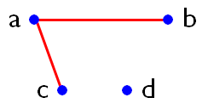
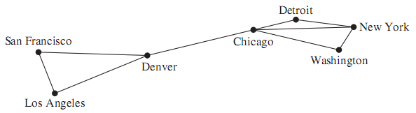
Graphs
Graphs = (vertices, edges) ➔ G = (V, E)
V = vertices = { a, b, c, d }
E = edges = { {a, b}, {a, c} }
Computer network

Slide 9
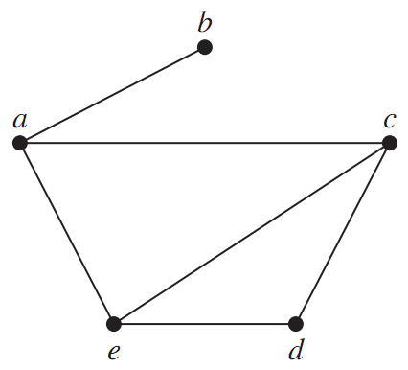
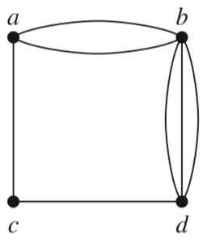
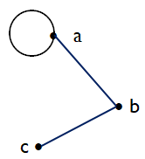
Simple graphs
Non-simple graph
with multi-edges
Non-simple graph
with loops
Simple graph

Slide 10
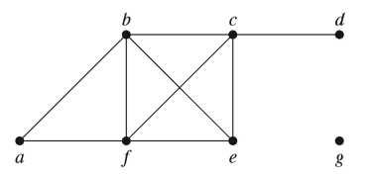
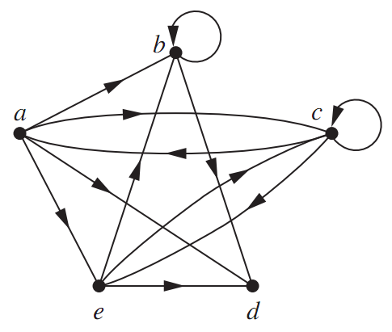
Types of graphs
An undirected graph
A directed graph
(digraph)

Slide 11
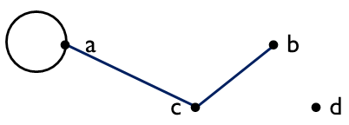
Basic Terminology
If an edge {u, v} exists, then u and v are called adjacent
The edge {u, v} is called incident with u and v
vertex | adjacency list
a | a, c
b | c
c | a, b
d
edge | incident vertices
{a, a} | a
{a, c} | a, c
{c, b} | c, b

Slide 12
Basic Terminology
The degree of a vertex v:
= the number of edges incident with v, except that a loop at a vertex contributes twice.
Notation: deg(v)
vertex | degree
a | 3
b | 1
c | 2
d | 0
b is called pendant
d is called isolated
∑_{degree}= 6
Remark: ∑_{degree} = 2| Edges |

Slide 13
THE HANDSHAKING THEOREM (for undirected graphs)
3 edges: {a, a}, {c, b}, {a, c}
deg(a) = 3
deg(b) = 1
deg(c) = 2
deg(d) = 0
∑_{deg}= 6
THE HANDSHAKING THEOREM:
(one edge = two degrees)
Σ_{v∈V}deg(v) = 2|E|
“the sum of the degrees is twice the number of edges”.
always EVEN

Slide 14
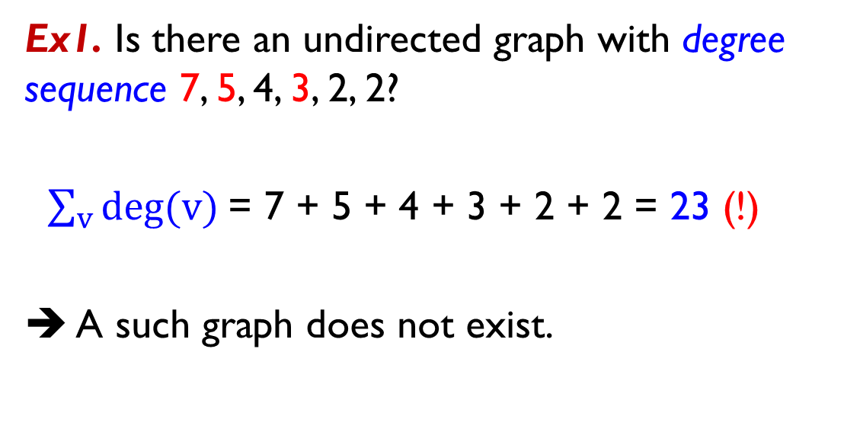
THE HANDSHAKING THEOREM - Examples
Ex1. Is there an undirected graph with degree sequence 7, 5, 4, 3, 2, 2?
$\sum_{v}{deg⁡(v)}$= 7 + 5 + 4 + 3 + 2 + 2 = 23 (!)
➔ A such graph does not exist.

Slide 15
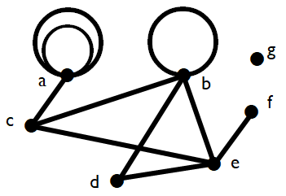
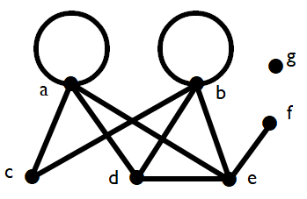
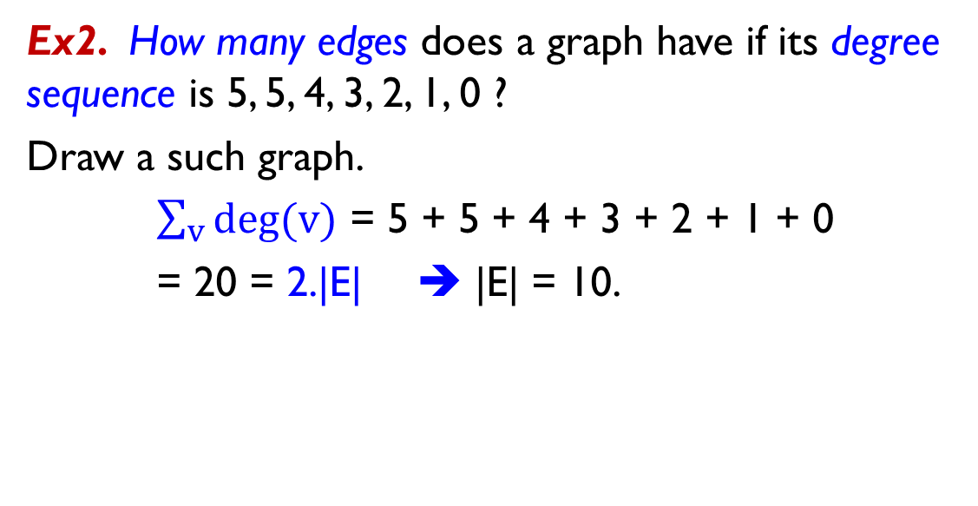
THE HANDSHAKING THEOREM - Examples
Ex2. How many edges does a graph have if its degree sequence is 5, 5, 4, 3, 2, 1, 0 ?
Draw a such graph.
$\sum_{v}{deg⁡(v)}$ = 5 + 5 + 4 + 3 + 2 + 1 + 0
= 20 = 2.|E| ➔ |E| = 10.

Slide 16
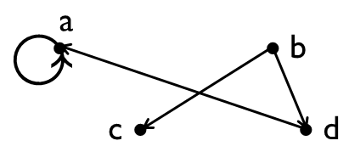
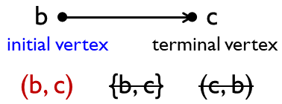
Directed graphs -Basic Terminology
Vertex | In-degree deg⁻ | Out-degree deg⁺
a | 2 | 1
b | 0 | 2
c | 1 | 0
d | 1 | 1
∑_{deg-} = ∑_{deg+}
= 4
directed edges

Slide 17
Some Special simple graphs
Complete graphs K_{n}
Cycles C_{n}
Wheels W_{n},
n-cubes Q_{n}
Questions:
How to construct?
Number of vertices
Number of edges
Degree sequence

Slide 18
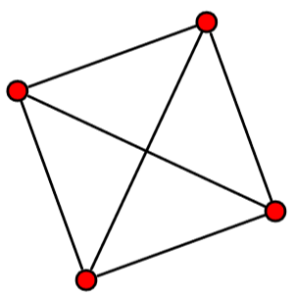
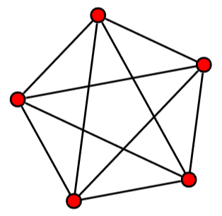
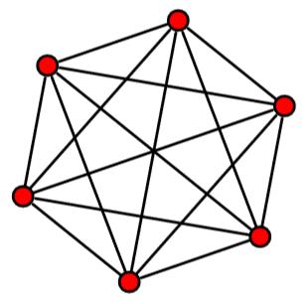
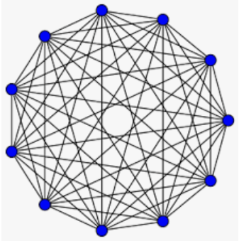
Special simple graphs
Complete graphs K_{n} (n ≥1)
K₄
K₅
K₆
K₁₁
Questions:
1/ K_{n} has ___ vertices and ___ edges.
Answer: n, C(n,2) = n(n-1)/2
2/ What is the degree of each vertex?
Answer: n - 1

Slide 19
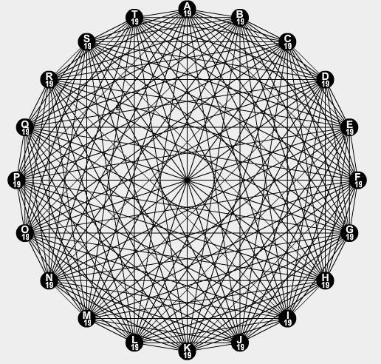
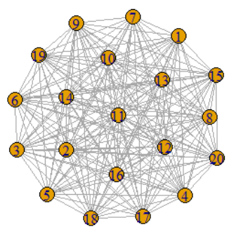
Ex. How many matches are there in the Premier League season?
K₂₀
C(20, 2) = 20.19/2
= 190 edges
➔ 380 matches
K₂₀

Slide 20

Complete graph K_{n} - example
C(64,2)
= 2016
edges

Slide 21
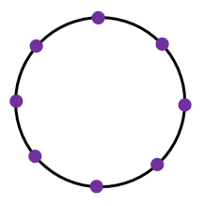
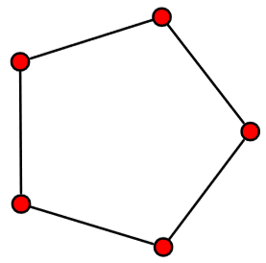
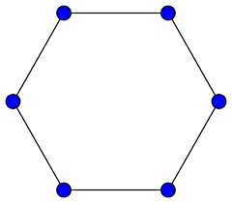
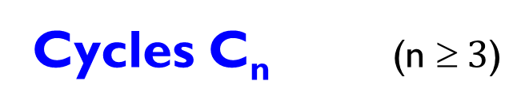
Cycles C_{n}
Cycles C_{n} (n $ 3$)
C₅
C₆
C₈
C_{n} has ___ vertices and ___ edges.
Answer: n, n

Slide 22
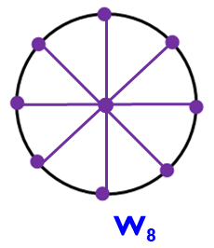
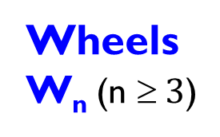
Wheels W_{n}
Cycles
C_{n}
C₅
C₆
C₈
Wheels
W_{n} (n $ 3$)
•
•
W₅
W₆
W_{n} has ___ vertices and ___ edges.
Answer: n+1, 2n

Slide 23
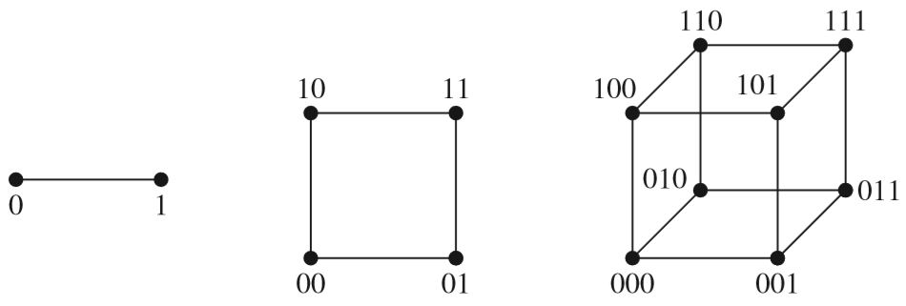
n-cubes Q_{n}
n-dimensional hypercube
1-D
2-D
3-D
Graph | |V| = number of vertices | |E| = number of edges
Q_{n} | 2^{n} | n.2^{n-1}

Slide 25
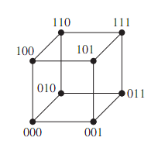
n-cube Q_{n}
Construct Q₄ from two copies of Q₃
0
1
0
0
0
0
1
1
0
1
1
0
0
1
1
0
1
1

Slide 26
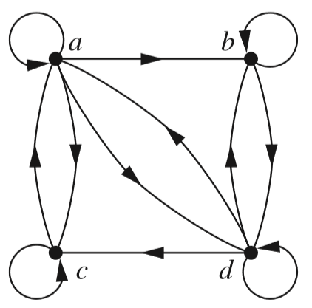
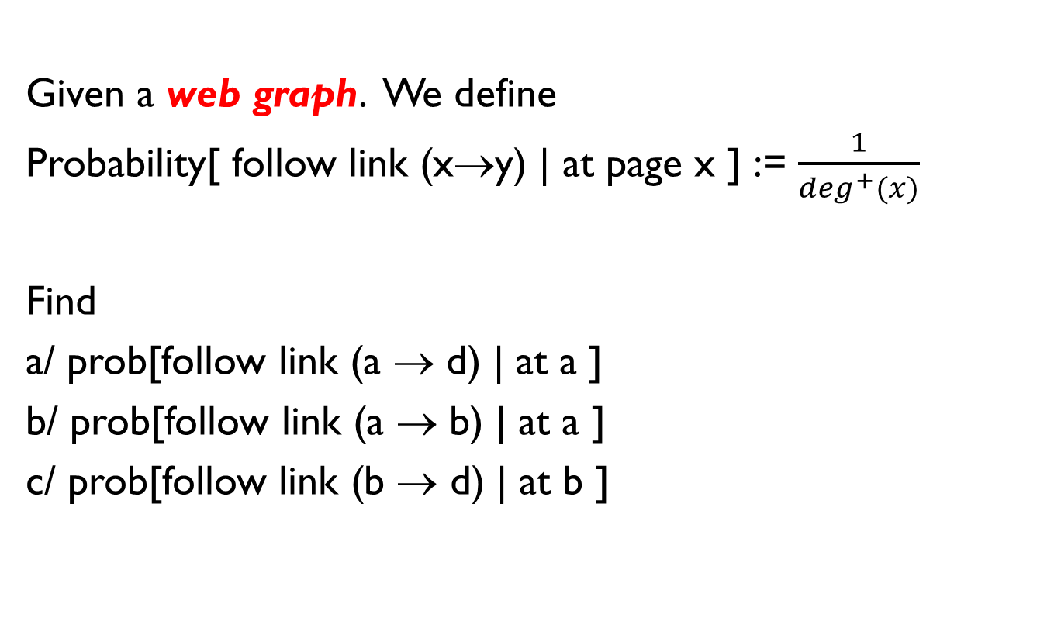
Exercises
Given a web graph. We define
Probability[ follow link (x→y) | at page x ] := $\frac{1}{\deg^{+}(x)}$
Find
a/ prob[follow link (a → d) | at a ]
b/ prob[follow link (a → b) | at a ]
c/ prob[follow link (b → d) | at b ]

Slide 27
Exercises
Ex1. Is there simple graph with degree sequence
5, 4, 3, 2, 1, 1, 0 ?
Suppose there is such a simple graph.
Let V = {a, b, c, d, e, f, g} be the vertex set, where their degrees are given below
deg(a) = 5 ➔ b, c, d, e, f must be adjacent to a (note that the graph is simple, has no loops and multiple-edges)
deg(e) = deg(f) = 1 ➔ e and f are adjacent to a, not to b
➔ deg(b) < 4 (!)
vertex | a | b | c | d | e | f | g
degree | 5 | 4 | 3 | 2 | 1 | 1 | 0

Slide 28
Review
Questions:
1/ What is a graph?
2/ What are vertices?
3/ What are edges?
4/ What is a loop?
5/ What is deg(c) ?
6/ What is a simple graph?
Graph = (vertices, edges)
Vertices = nodes
Edges: edges, loops
Types: simple, undirected, directed, mixed, etc.
Undirected:
degree
Σ_{degree} = 2* number of edges
Directed:
in-degree, out-degree
Σ_{in-degree} = Σ_{out-degree}
edge
node/vertex
a
 b
 d
c 
loop

Slide 29
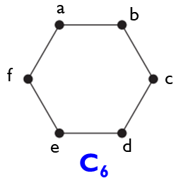
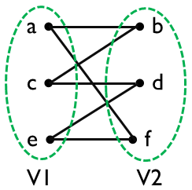
Bipartite graphs
A simple graph G = (V, E) is called bipartite if:
V = V1∪ V2, V1 ∩ V2 = ∅
no edge connects two vertices in V1
no edge connects two vertices in V2
We call the pair (V1,V2) a bipartition of V.
Ex. Study graph C₆ (cycle)
V = { a, b, c, d, e, f }
V1 = {a, e, c} ae ac ec
V2 = {b, f, d} bf bd fd
➔ C₆ is bipartite
➔

Slide 30
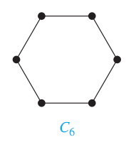
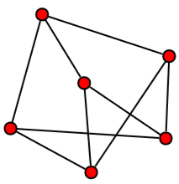
Bipartite graphs
How to check?
Ex.
a
b
Let color the vertices using 2 different colors
Two adjacent vertices must have different colors (e.g., red and black)
•
➔ C₆ is bipartite
V1 = {a, c, e}
V2 = {b, d, f}
f
•
c
•
e
d
a
c
•
•
d
bipartite
V1 = {a, e, f}
V2 = {b, c, d}
b
•
f
e

Slide 31
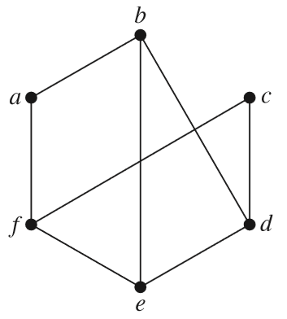
Example
Ex. Is the graph G bipartite?
•
•
?
➔ G is not bipartite
•
G

Slide 32
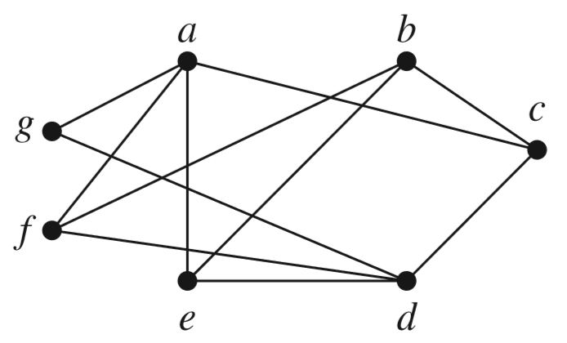
Bipartite?

Slide 33
K_{m,n} - Complete bipartite graphs
m = 3
n = 5
K_{3,5}
K_{m,n} has ___ vertices and ___ edges.
Answer: m + n, m.n

Slide 34
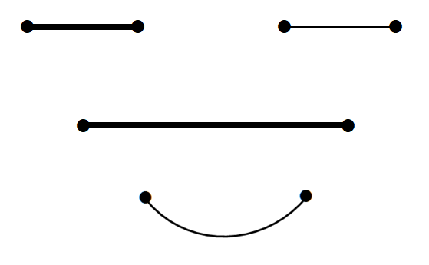
Isomorphism
THE SAME

Slide 35
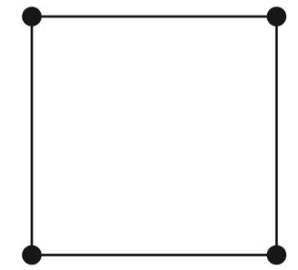
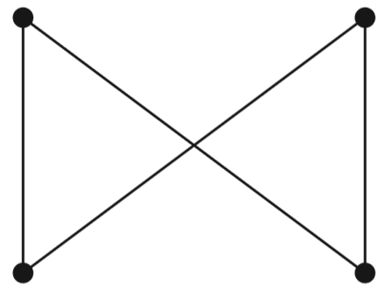
Isomorphism
a
b
m
n
G1 = (V1, E1), G2 = (V2, E2)
G1 and G2 are called isomorphic if
function f: V1 → V2
One-to-one
Onto
a, b are adjacent in V1
⇔ f(a), f(b) are adjacent in V2
•
•
•
•
•
•
•
•
p
q
c
d
function f = {(a, m); (b, p); (d, n); (c, q)}
➔ Two graphs are called isomorphic

Slide 36
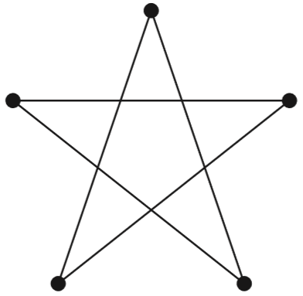
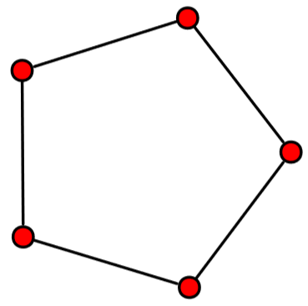
Isomorphic?
YES

Slide 37
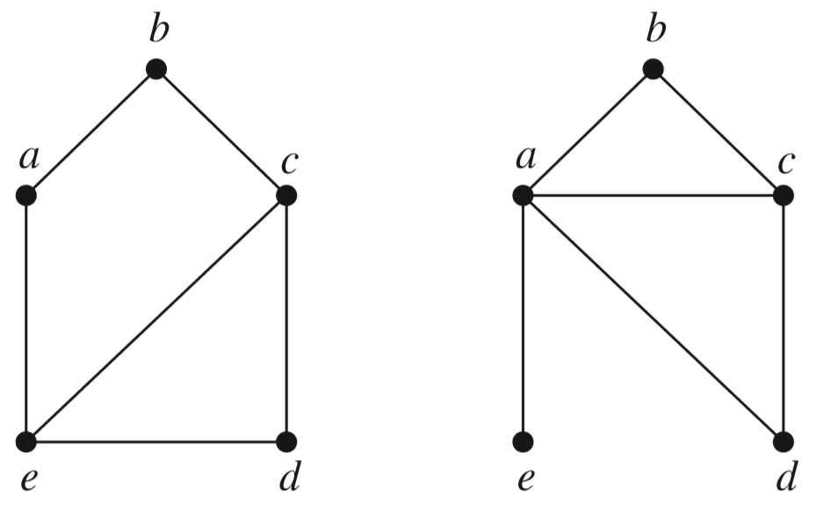
Isomorphic?
G
H
G and H are NOT isomorphic
(in H: deg(e) = 1, no vertex in G has degree 1)

Slide 38
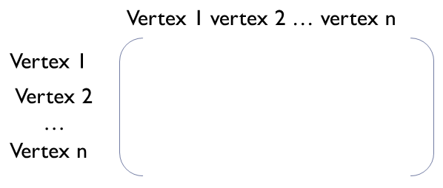
Representing graphs
Adjacency matrix
Incidence matrix
edge 1 edge 2 … edge m
Vertex 1
Vertex 2
…
Vertex n

Slide 39
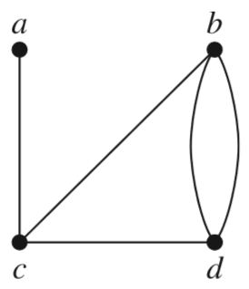
Adjacency matrices
Adjacency matrix.
A = [a_{ij}],
where a_{ij} = the number of edges that are associated to {v_{i}, v_{j}}
?
 | a | b | c | d
a | 0 | 0 | 1 | 0
b | 0 | 0 | 1 | 2
c | 1 | 1 | 0 | 1
d | 0 | 2 | 1 | 0

Slide 40
Example.
Given the adjacency matrix representing an
undirected graph G.
Find the deg(c).
 | a | b | c | d
a | 1 | 2 | 1 | 0
b | 2 | 0 | 2 | 2
c | 1 | 2 | 1 | 0
d | 0 | 2 | 0 | 0
(c, c) ➔ loop
deg(c) = 1+2+1⋅2 + 0 = 5

Slide 41
In 2010 the Web graph was estimated to have at least 55 billion vertices and one trillion edges. This implies that more than 40 TB of computer memory would have been needed to represent its adjacency matrix.

Slide 42
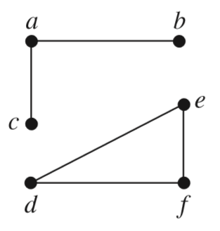
Incidence matrices
e₆
e₁
 | e₁ | e₂ | e₃ | e₄ | e₅ | e₆
a | 1 | 1 | 0 | 0 | 0 | 0
b | 1 | 0 | 0 | 0 | 0 | 1
c | 0 | 1 | 0 | 0 | 0 | 0
d | 0 | 0 | 1 | 1 | 0 | 0
e | 0 | 0 | 1 | 0 | 1 | 0
f | 0 | 0 | 0 | 1 | 1 | 0
g | 0 | 0 | 0 | 0 | 0 | 0
edges ➔
e₂
e₃
e₅
e₄
Vertices = { a, b, c, d, e, f }
Edges = { e₁, e₂, e₃, e₄, e₅, e₆ }

Slide 43
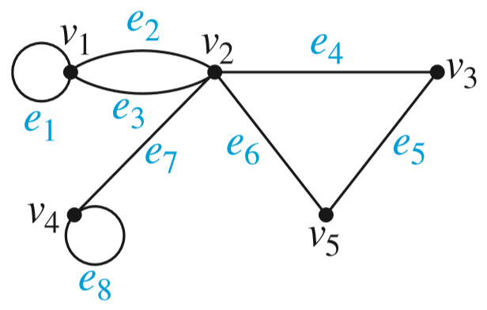
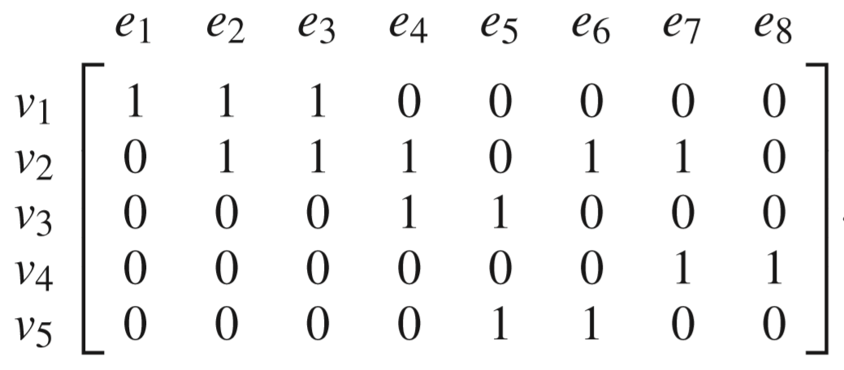
Incidence matrices
How many loops are there?
Answer: 2
Find deg(v₄).
Answer: deg(v₄) = 1 + 2.1 = 3

Slide 44
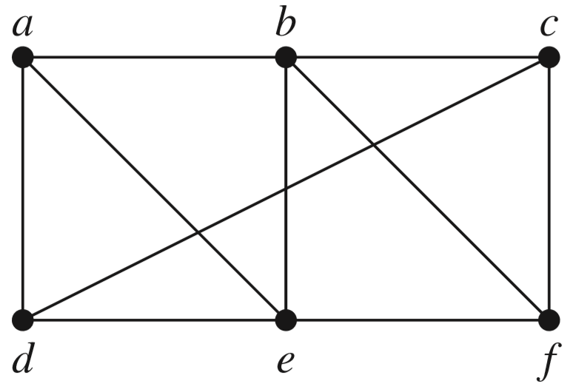
A path of length n
A path of length n from u to v:
A sequence of n consecutive edges
Ex.
a, e, f, c, d
is a path of length 4.






Slide 45
Circuits
A circuit is a path of length greater than zero that starts and ends at the same vertex.
Ex.
c, b, e, a, d, c is circuit.






Slide 46
Simple paths/circuits
A path/circuit is simple if it does not contain the same edge more than once.
Ex.
b, e, a, b, f, c
is a simple path.
c, b, e, a, d, e, b, f, c
is NOT a simple circuit.







Slide 47


Connectedness in Undirected Graphs
Connected = there is a path between every pair of distinct vertices of the graph.
Not connected = disconnected.
G
A disconnected with
3 connected components
G is connected

Slide 48



Connectedness in Directed Graphs
Strongly connected vs weakly connected
G
H
G: strongly connected
➔ weakly connected
✪
H: weakly connected
connected
Notes:
A directed graph is weakly connected if and only if there is always a path between two vertices when the directions of the edges are disregarded.
Note that if a directed graph is strongly connected, then it is also weakly connected.

Slide 49




Counting Paths Between Vertices
How many paths of length four from a to d in the simple graph G?
The adjacency matrix of G is given below
(ordering the vertex as a, b, c, d)
to
from
G
Result = 8


Slide 50

Shortest-path problems
weight
Notes:
Many problems can be modeled using graphs with weights assigned to their edges.
A basic graph model: representing cities by vertices and flights by edges.
Problems involving distances: assigning distances between cities to the edges.
Problems involving flight time: assigning flight times to edges.
Problems involving fares: assigning fares to the edges.

Slide 51


Shortest-path problems

Slide 52

Find the shortest path from a to z.

Slide 53
Dijkstra’s algorithm
c
d
∞
11
∞
3
3
14
12
11
11
12
3
6
a
0
2
0
4
∞
z
23
25
23
5
8
9
16
∞
∞
8
7
9
7
9
b
e
S = {a,
c,
b,
e,
d,
z}
The shortest path from a to z: a, c, e, d, z

Slide 54

Dijkstra’s Algorithm
O(n²)
time complexity
Notes:
Dijkstra’s algorithm for finding the shortest path between a and z in a connected simple undirected weighted graph.
Dijkstra’s algorithm proceeds by finding the length of a shortest path from a to a first vertex, the length of a shortest path from a to a second vertex, and so on, until the length of a shortest path from a to z is found.
The algorithm relies on a series of iterations.
S: a distinguished set of vertices is constructed by adding one vertex at each iteration.
L(v): the label of vertex v.
A vertex w is labeled with the length of a shortest path from a to w that contains only vertices already in the distinguished set.
The vertex added to the distinguished set is one with a minimal label among those vertices not already in the set.

Slide 55
Pseudocode
procedure shortestpath(w[ , ]: matrix of weights of a connected graph G)
L[1]: = 0 # starting node is vertex no. 1, labeled as 0
for i:=2 to n # n = number of nodes
L[i] := Inf # label vertices as ∞ by default
for i:=1 to n
s[i]: = 0 # the set S is empty as default, s[i] = 0 means vertex i∉S
minlabel := L(1) # vertex 1 has minimum label
u:=1 # the first choice is vertex 1, starting one
while (s[z]=0) # while vertex no. z is NOT in S
for v:=1 to n # looking for the node with minimum label
if ( s[v] = 0 & L[v] < minlabel ) # vertex v∉S with L(v) < minlabel
u: = v # choose vertex v
minlabel := L[v] # update minlabel
s[u]: = 1 # add vertex u to S by setting s[u] = 1
for v: = 1 to n
if (s[v] = 0) # v is not in S
L[v] := min{L[u]+w[u,v], L[v]}
# update L[v]
return L(z) {L(z) is the length of the shortest path}

Slide 56



Euler and Hamilton paths - introduction
Can one travel across all the bridges once and return to the starting point?
LEONHARD EULER
(1707–1783)
The Seven Bridges of Königsberg.
Multigraph Model

Slide 57

Euler circuit/path - definitions
An Euler path/circuit in a graph G is a simple path/circuit containing every edge of G.
G₁ has an Euler circuit
a, b, e, d, c, e, a
G₃ has no an Euler circuit,
But G₃ has an Euler path
a, c, d, e, b, d, a, b

Slide 58


Euler circuit
Theorem.
A connected multigraph, ≥ 2 vertices,
has an Euler circuit ⇔ every vertex has even degree
3
NOT OK
2
2
OK
4
2
2

Slide 59
How to construct an Euler circuit?
procedure Euler(G: connected, every vertex has even degree)
construct a simple circuit in G
H:= G – circuit // remove passed edges
while H has edges
construct a simple subcircuit in H beginning at a vertex in circuit
H: = H – subcircuit // remove passed edges
circuit : = add subcircuit to circuit
{ circuit is an Euler circuit }
a •
• d
b •
• c
G
e •
• f
• c
H
e •
• f
circuit: a, b, c, d, a
subcircuit: c, e, f, c
➔ circuit: a, b, c, e, f, c, d, a

Slide 60
Euler path
Theorem.
A connected multigraph has
an Euler path but not an Euler circuit
⇔
it has exactly
two vertices of odd degree
Note that: an Euler circuit is also an Euler path

Slide 61



Example
Does the given graph have an Euler circuit ?
K_{4,12}

Slide 62


Hamilton Paths and Circuits
Hamilton circuit/path:
A simple circuit/path passes through every vertex exactly once.
start
?
end
Hamilton path
No Hamilton circuit
a,b,c,d,e is a Hamilton path
Notes:
Note that Hamilton circuits and Hamilton paths are SIMPLE paths, which do not contain the same edge more than once.
Not that having an Hamilton circuit implies the existence of an Hamilton path.

Slide 63

Example - A Hamilton circuit for Q₃

Slide 64
Hamilton Paths and Circuits
There are
NO known simple necessary and sufficient criteria
for the existence of
Hamilton circuits

Slide 65



Hamilton circuits - sufficient conditions
Dirac’s theorem.
Ore’s theorem.
G is a graph:
simple
n ( ≥ 3) vertices
∀v_{i}, deg(v_{i}) ≥ $\frac{n}{2}$

G has a Hamilton circuit
2 3
2
3 3
?
G is a graph:
simple
n ( ≥ 3) vertices
∀u, ∀v, non-adjacent
deg(u) + deg(v) ≥ n

G has a
Hamilton circuit

Slide 66

The Traveling Salesman Problem
Total Distance
= 58 + 133 + 137 + 113 + 147
= 588
Salesman starts in one city (ex. Detroit). He wants to visit n cities exactly once and return to his starting point (Detroit). In which order should he visit theses cities to travel the minimum total distance ?
Notes:
- The Traveling Salesman Problem is an important problem involving weighted graphs.

Slide 67


The Traveling Salesman Problem
$$\frac{4!}{2}=12$$
Exhaustive search technique // vét cạn
[(n-1) (n-2) (n-2) … 3.2.1]/2 = (n-1) !]/2 ➔ O((n-1)!) complexity
➔ Approximation algorithm

Slide 68
Summary
9.1- Graphs and Graph Models
9.2- Graph Terminology and Special Types of Graphs
9.3- Representing Graphs and Graph Isomorphism
9.4- Connectivity
9.5- Euler and Hamilton Paths
9.6- Shortest Path Problems

Slide 69
1/ Draw an undirected graph with degree sequence 5,4,3,2,0. Is the graph connected?
2/ An undirected graph G has five vertices of degree 3 and three vertices of degree five. If a graph H is isomorphic to G, how many edges does H have?
3/ Given a adjacency matrix of a graph.
How many paths of length 2 from a to c?
4/ Find n and m for which each of the following graphs has an/a Euler/Hamilton circuit.
a b c d
a
b
c
d
Graph | K_{n} | C_{n} | W_{n} | Q_{n} | K_{m,n}
Euler circuit
Hamilton circuit

Slide 70
THANKS

